Slide 1
Student Exam Mark Analysis using Excel
STUDENT NAME: MANIKANDAN .S
REGISTER NO: 312207307
DEPARTMENT: COMMERCE
COLLEGE: C.KANDASWAMI NAIDU COLLEGE FOR MEN

Slide 2
PROJECT TITLE
STUDENT MARK ANALYSIS using Excel

Slide 3


AGENDA
Problem Statement
Project Overview
End Users
Our Solution and Proposition
Dataset Description
Modelling Approach
Results and Discussion
Conclusion
3/21/2024 Annual Review

Slide 4

PROBLEM STATEMENT
"Student exam mark analysis reveals patterns of academic performance, indicating areas of strength and opportunities for improvement. By examining the distribution of scores, identifying trends in performance over time, and comparing results across different subjects, educators can better understand student learning outcomes and tailor interventions to support academic growth."

Slide 5

PROJECT OVERVIEW
The primary goal of this project is to leverage employee data analysis to enhance workforce management, optimize productivity, and support strategic decision-making within the organization. By systematically collecting, analyzing, and interpreting employee data, the project aims to uncover actionable insights that will drive improvements in employee performance, retention, and overall organizational efficiency.

Slide 6

WHO ARE THE END USERS?
The end uses of a student mark list include: 1. *Academic Progress Tracking*: Monitoring students' performance over time to assess their progress and identify areas for improvement. 2. *Promotion and Graduation Decisions*: Determining whether students meet the necessary criteria for moving to the next grade level or graduating. 3. *Parent-Teacher Conferences*: Providing a basis for discussions with parents about their child’s academic strengths and weaknesses. 4. *Scholarship and Award Eligibility*: Evaluating students for academic scholarships, honors, or awards based on their marks. 5. *Curriculum and Instruction Adjustment*: Informing educators about the effectiveness of teaching methods and curriculum, guiding adjustments to better meet students' needs.

Slide 7

OUR SOLUTION AND ITS VALUE PROPOSITION
Solution: Student mark analysis involves collecting and interpreting data on student performance to gain insights into academic outcomes. This process typically includes:1. *Data Collection*: Gathering exam scores, grades, and other relevant academic data.2. *Data Analysis*: Using statistical tools and software to analyze performance trends, identify patterns, and assess strengths and weaknesses.3. *Reporting*: Creating detailed reports and visualizations to present findings clearly to educators, students, and parents.4. *Actionable Insights*: Providing recommendations for curriculum adjustments, targeted interventions, and personalized support plans based on the analysis.*Value Proposition:*1. *Enhanced Decision-Making*: Empowers educators and administrators with data-driven insights to make informed decisions about curriculum, teaching strategies, and resource allocation.2. *Targeted Interventions*: Identifies students who need additional support or enrichment, allowing for more effective and personalized interventions.3. *Improved Academic Outcomes*: Helps in developing strategies to address learning gaps, ultimately leading to better student performance and achievement..

Slide 8
Dataset Description
*Student Mark List Analysis* is the process of evaluating and interpreting the data contained in students' mark lists or grade sheets. This analysis involves a systematic approach to understanding the academic performance of students, identifying trends, and drawing meaningful conclusions that can inform educational strategies.

Slide 9

THE "WOW" IN OUR SOLUTION
The "wow" factor of student mark list analysis lies in its ability to transform raw academic data into powerful insights that can significantly enhance educational outcomes. Here's why it stands out *Personalized Education at Scale*Student mark analysis enables educators to identify each student's unique strengths and weaknesses, allowing for highly personalized learning experiences. It’s like having a tailored educational plan for every student, but applied across an entire class or school.
3/21/2024 Annual Review
9

Slide 10
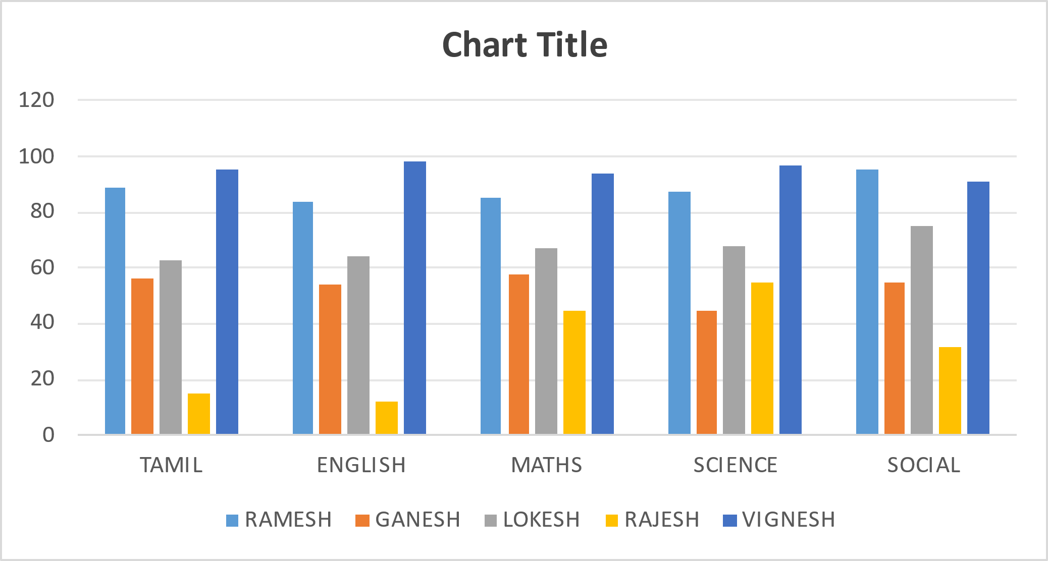
MODELLING
STUDENT | TAMIL | ENGLISH | MATHS | SCIENCE | SOCIAL
GANESH
 | 56
 |  | 54
 |  |  | 58
 |  |  |  | 45
 |  |  |  |  | 55
LOKESH
 | 63
 |  | 64
 |  |  | 67
 |  |  |  | 68
 |  |  |  |  | 75
RAJESH
 | 15
 |  | 12
 |  |  | 45
 |  |  |  | 55
 |  |  |  |  | 32
RAMESH
 | 89
 |  | 84
 |  |  | 85
 |  |  |  | 87
 |  |  |  |  | 95
VIGNESH
 | 95
 |  | 98
 |  |  | 94
10

Slide 11
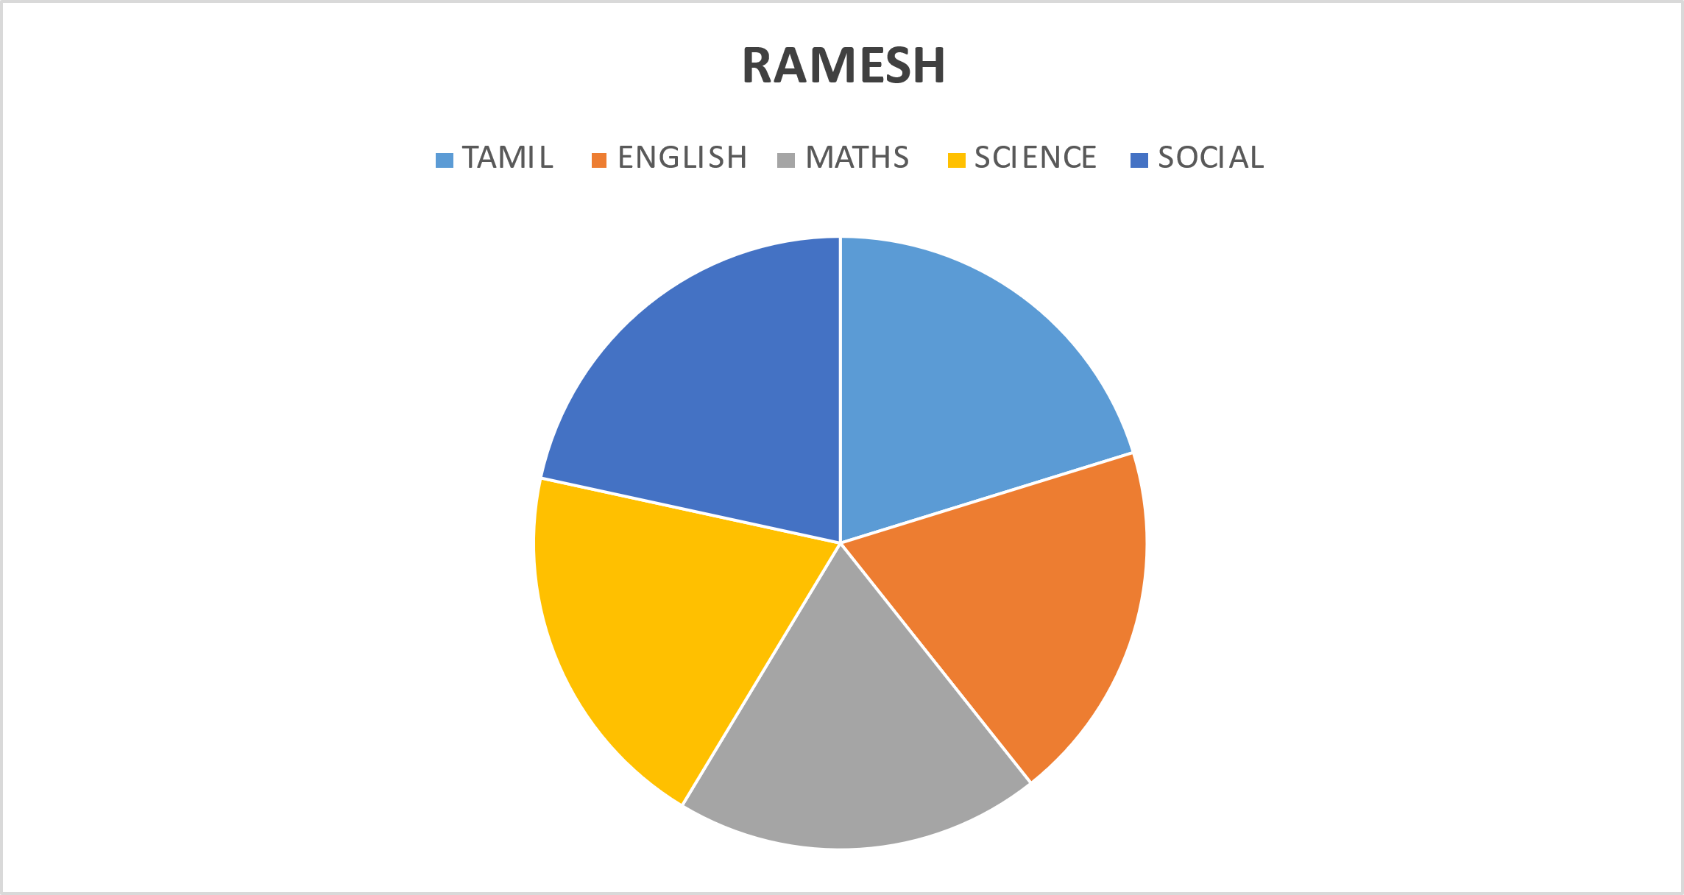
RESULTS
STUDENT | TAMIL | ENGLISH | MATHS | SCIENCE | SOCIAL
RAMESH | 89 | 84 | 85 | 87 | 95
GANESH | 56 | 54 | 58 | 45 | 55
LOKESH | 63 | 64 | 67 | 68 | 75
RAJESH | 15 | 12 | 45 | 55 | 32
VIGNESH | 95 | 98 | 94 | 97 | 91
11

Slide 12
conclusion
Student mark list analysis is a vital tool in modern education, offering deep insights into academic performance that drive personalized learning, informed decision-making, and continuous improvement. By transforming raw data into actionable intelligence, this analysis empowers educators to tailor interventions, predict future outcomes, and enhance overall educational quality. Ultimately, it ensures that every student receives the support they need to succeed, fostering a data-driven approach to learning and teaching.

